Slide 1
Building Your Brand
Strategies for Internal and External Success

Slide 2
Attention
MMS sessions are 60-75 minutes followed by LONG Q&A
Please hold detailed questions until that Q&A starts
Feel free to ask clarification questions
Remind the speakers to use Zoom It when you can’t see

Slide 3
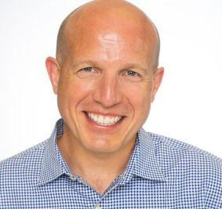



Chad Lich
Scott Corio
Director Azure Infrastructure Specialist
Microsoft MVP
bluesky4x4
in/chadlich
dumpsterdave
in/scottcorio

Slide 4
Know Before You Show (up to our session)
What you want to be when you grow up
What objectives or goals do you have?
What is your comfort zone?
What are you confident about, comfortable with, anxious about, and scared to death of?

Slide 5
Topics we’ll cover
Social Media
Things to do, avoid, not do, and never, ever, ever do
Which platforms to use, and how to best leverage them
Growth opportunities
How to identify and approach opportunities
Stretch assignments – spreading your wings or falling out of the nest
Continued Education
How to stay relevant in a constantly evolving market and field
Adding value to your organization as an individual contributor
Branding
How to sell yourself

Slide 6
Visibility with Leadership
The corporate tree extends (well) beyond your direct manager
Schedule at least a quarterly meeting with your skip level
Schedule an annual with your skip-skip level (if possible)
The corporate tree has branches, don’t focus solely on the trunk
Build a strong relationship with your lateral organizations (endpoint, infrastructure, security, etc.
Be an enabler for revenue driving groups, don’t just be a cost center.
Don’t say No
When you have to put up a roadblock, suggest alternatives or possible options with it. Don’t just leave it as “NO”. That’s for the security dept to say.

Slide 7
Stretch Assignments
Think of Stretch Assignments as a mini-interview for your next role
Could be vertical growth (IC to Supervisor/Manager)
Could be lateral growth (Endpoint to Infrastructure or Security)
Stretch Assignments should take you out of your comfort zone to push what you think you are capable of or what is expected of you.
Work with leadership to identify opportunities
Your personal goals should include at least one stretch assignment each year

